Slide 1
GRADE 7 ACCELERATED · UNIT 3 · LESSON 3
Exponential Expressions
MA.7.NSO.1.1
I can apply more than one law of exponents to evaluate an expression and to write an equivalent one.
Grade 7 Accelerated · Unit 3 · Lesson 3 — Exponential Expressions
1

Slide 2
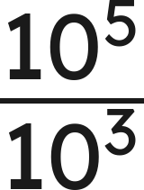
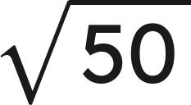


Warm-Up
1. Find the value:
2. Is
closer to 7 or to 8?
3. Solve
4. Evaluate
Grade 7 Accelerated · Unit 3 · Lesson 3 — Exponential Expressions
2

Slide 3
Warm-Up
1. Find the value:
100
2. Is
closer to 7 or to 8?
7
3. Solve
x = 5
4. Evaluate
50
Grade 7 Accelerated · Unit 3 · Lesson 3 — Exponential Expressions
3

Slide 4
Notes
I. The seven laws, in one place
Law | Rule | Example
Product of powers | a^{m} · a^{n} = a^{m+n} | 2³ · 2¹ = 2⁴
Quotient of powers | a^{m} ÷ a^{n} = a^{m-n} | (−3)⁷ ÷ (−3)² = (−3)⁵
Power of a product | (ab)^{m} = a^{m} · b^{m} | (−7 · 3)² = (−7)² · 3²
Power of a quotient | (a ÷ b)^{m} = a^{m} ÷ b^{m} | (13 ÷ 5)³ = 13³ ÷ 5³
Power of a power | (a^{m})^{n} = a^{mn} | (6³)⁴ = 6¹²
Identity exponent | a¹ = a | 15¹ = 15
Zero exponent | a⁰ = 1 | 127⁰ = 1
Grade 7 Accelerated · Unit 3 · Lesson 3 — Exponential Expressions
4

Slide 5
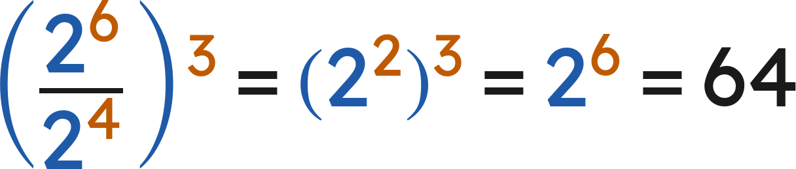
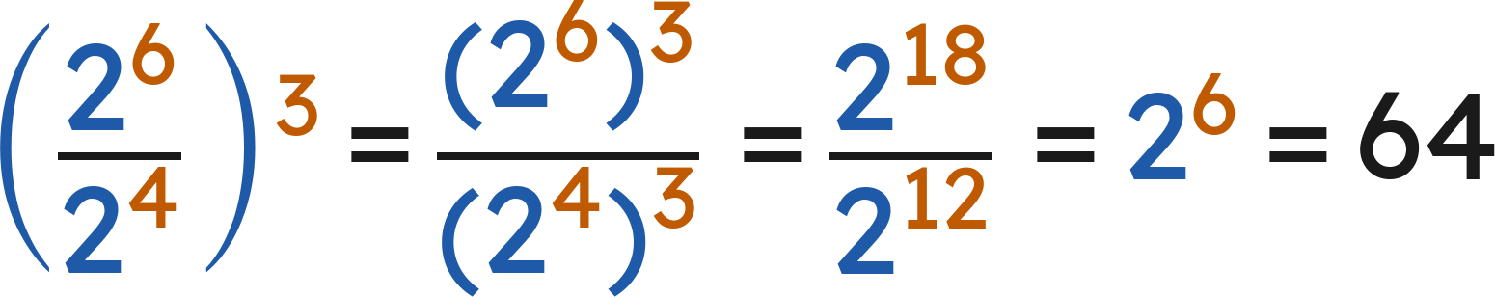
Notes
II. More than one law — make a plan, then follow it
Winston:
Yvette:
Different plans, same value. Any correct sequence of laws gives the same answer.
Grade 7 Accelerated · Unit 3 · Lesson 3 — Exponential Expressions
5

Slide 6
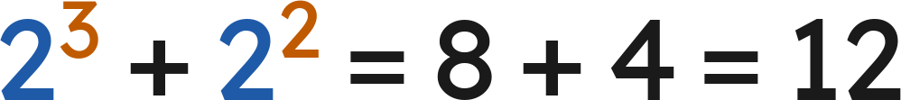

Notes
III. Order of operations still applies
A.
Parentheses first — including a fraction bar, which is a pair of parentheses in disguise.
B.
Exponents next — the laws of exponents are applied here.
C.
Then multiply and divide, left to right; then add and subtract.
D.
Never across a + or a −:
, not
.
Grade 7 Accelerated · Unit 3 · Lesson 3 — Exponential Expressions
6

Slide 7
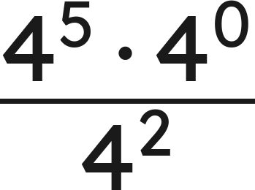
Example 1
Make a plan. Then find the value.
Grade 7 Accelerated · Unit 3 · Lesson 3 — Exponential Expressions
7

Slide 8
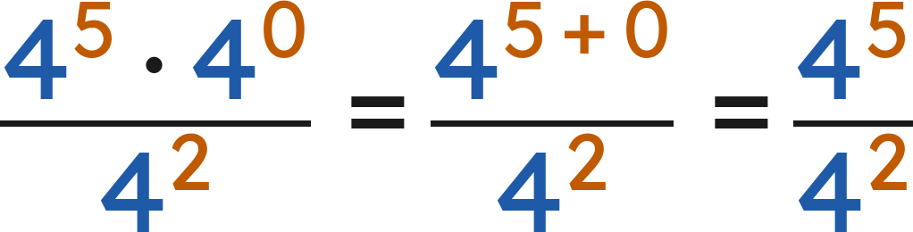
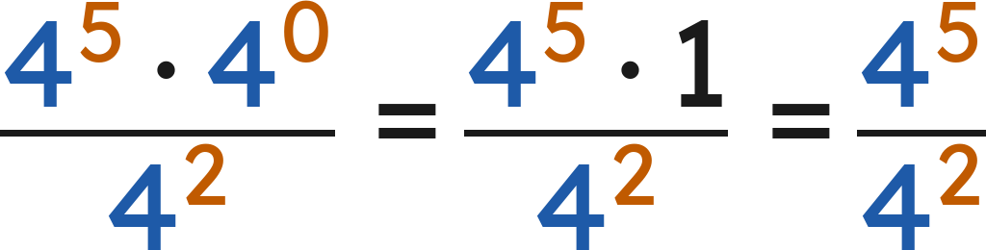
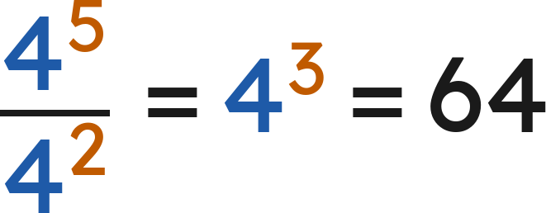
Example 1
Answer: 64
Grade 7 Accelerated · Unit 3 · Lesson 3 — Exponential Expressions
8

Slide 9
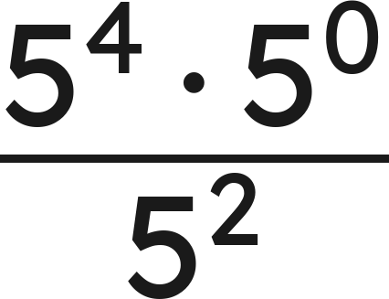
Your Turn
Make a plan. Then find the value.
Grade 7 Accelerated · Unit 3 · Lesson 3 — Exponential Expressions
9

Slide 10
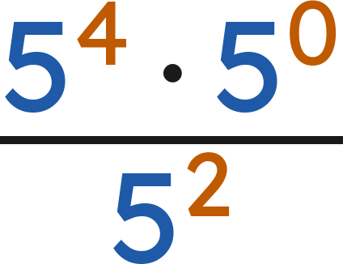
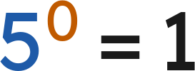

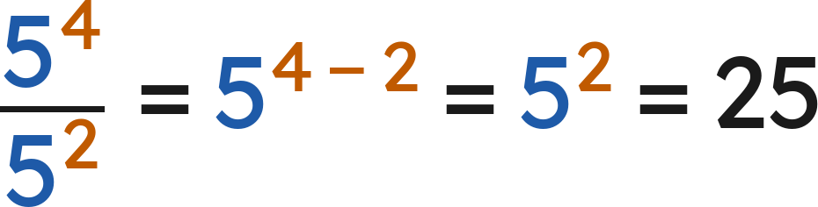
Your Turn
Make a plan. Then find the value.
, so the top is
Answer: 5² = 25
Grade 7 Accelerated · Unit 3 · Lesson 3 — Exponential Expressions
10

Slide 11
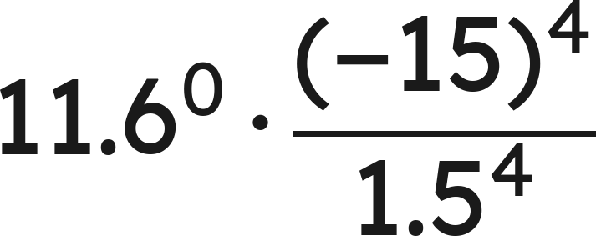
Example 2
Make a plan. Then find the value.
Grade 7 Accelerated · Unit 3 · Lesson 3 — Exponential Expressions
11

Slide 12
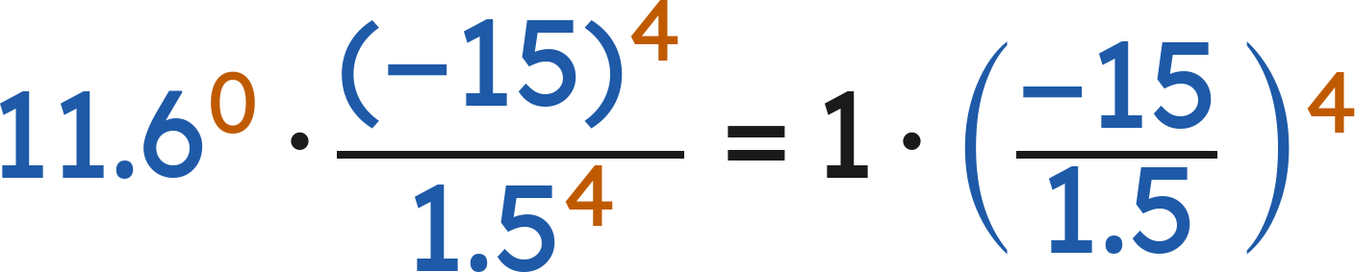
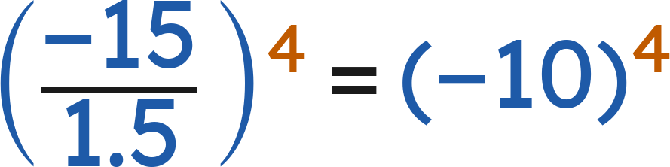
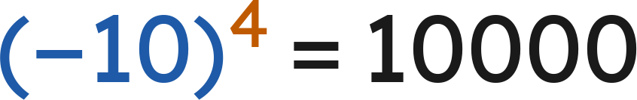
Example 2
Answer: 10,000
Grade 7 Accelerated · Unit 3 · Lesson 3 — Exponential Expressions
12

Slide 13
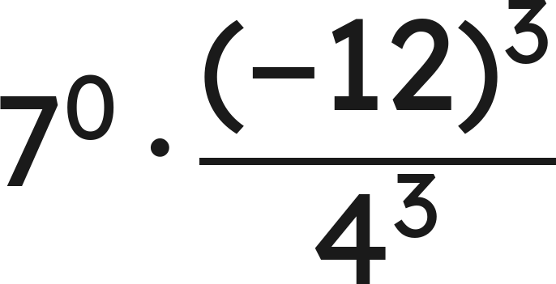
Your Turn
Make a plan. Then find the value.
Grade 7 Accelerated · Unit 3 · Lesson 3 — Exponential Expressions
13

Slide 14
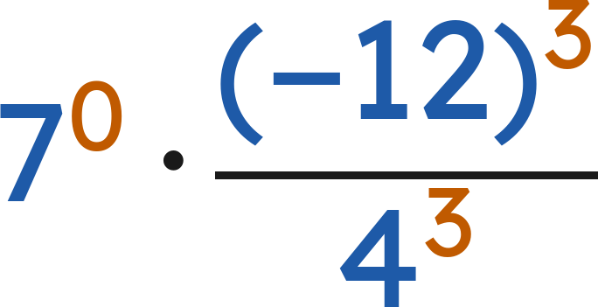
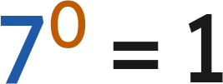
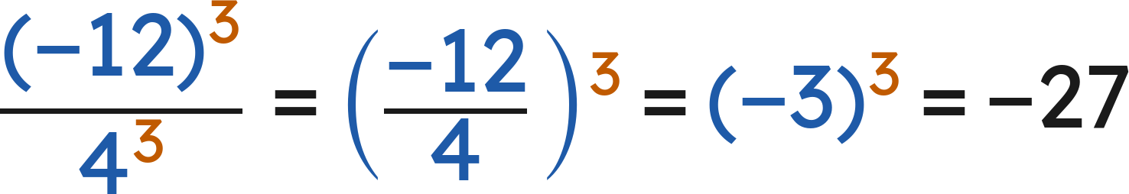
Your Turn
Make a plan. Then find the value.
Answer: −27
Grade 7 Accelerated · Unit 3 · Lesson 3 — Exponential Expressions
14

Slide 15


Whiteboards · Question 1 of 9
A warehouse holds
boxes in
equal rows.
Each box weighs 3 kilograms.
How many boxes are in each row?
Answer it.
Grade 7 Accelerated · Unit 3 · Lesson 3 — Exponential Expressions
15

Slide 16



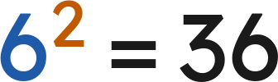
Whiteboards · Question 1 of 9
A warehouse holds
boxes in
equal rows.
Each box weighs 3 kilograms.
How many boxes are in each row?
Answer: 36
Grade 7 Accelerated · Unit 3 · Lesson 3 — Exponential Expressions
16

Slide 17
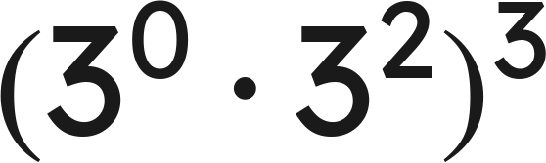
Whiteboards · Question 2 of 9
Answer it.
Grade 7 Accelerated · Unit 3 · Lesson 3 — Exponential Expressions
17

Slide 18
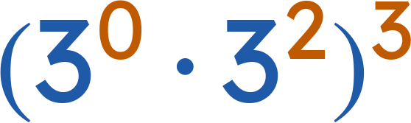

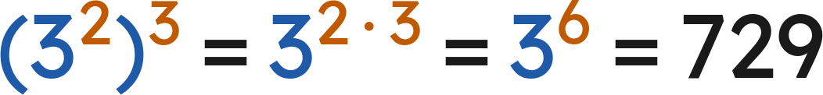
Whiteboards · Question 2 of 9
Inside first:
Answer: 729
Grade 7 Accelerated · Unit 3 · Lesson 3 — Exponential Expressions
18

Slide 19
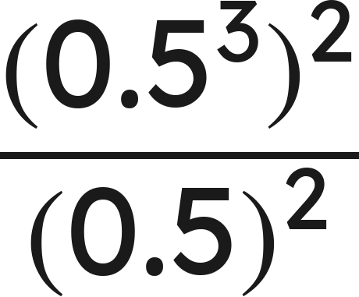
Whiteboards · Question 3 of 9
Answer it.
Grade 7 Accelerated · Unit 3 · Lesson 3 — Exponential Expressions
19

Slide 20
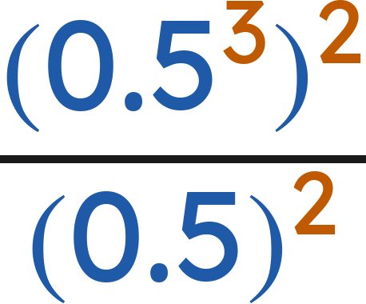
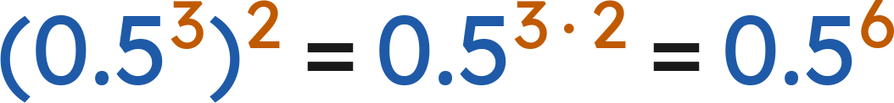
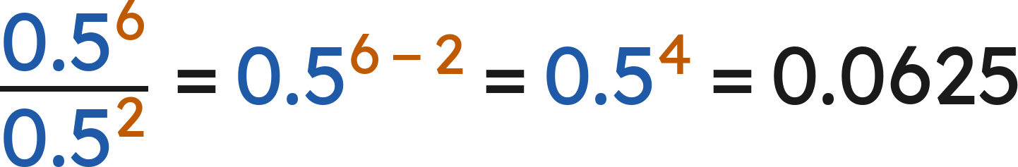
Whiteboards · Question 3 of 9
Top:
Answer: 0.0625
Grade 7 Accelerated · Unit 3 · Lesson 3 — Exponential Expressions
20

Slide 21
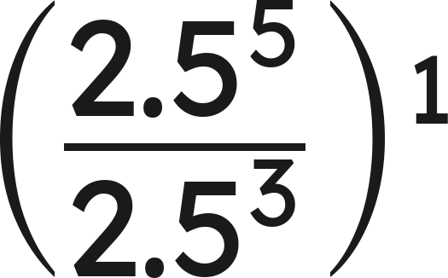
Whiteboards · Question 4 of 9
Answer it.
Grade 7 Accelerated · Unit 3 · Lesson 3 — Exponential Expressions
21

Slide 22
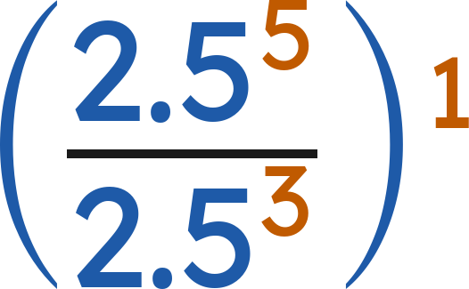
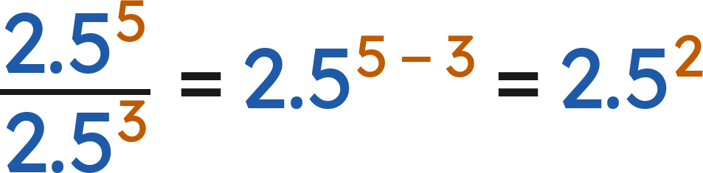
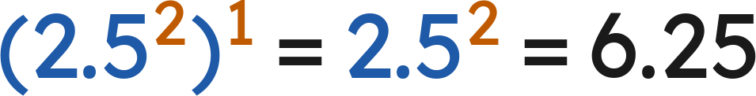
Whiteboards · Question 4 of 9
Answer: 6.25
Grade 7 Accelerated · Unit 3 · Lesson 3 — Exponential Expressions
22

Slide 23
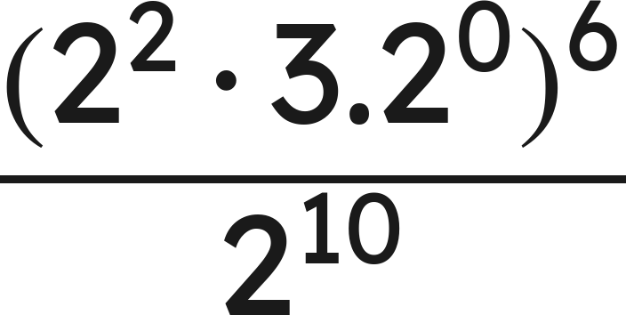
Whiteboards · Question 5 of 9
Which is the value?
A. 1/4
B. 2²²
C. 0
D. 4
Answer it.
Grade 7 Accelerated · Unit 3 · Lesson 3 — Exponential Expressions
23

Slide 24
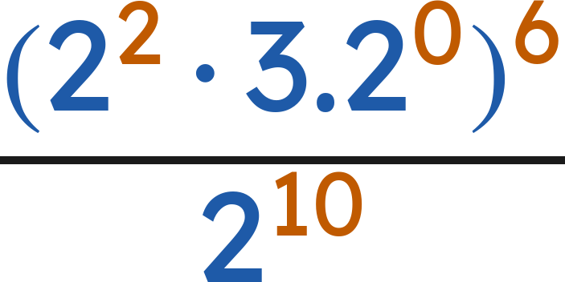
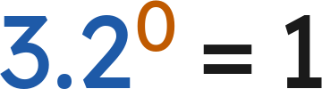
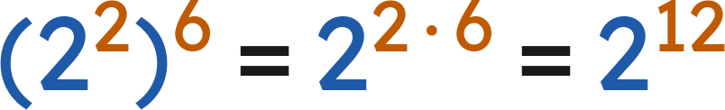
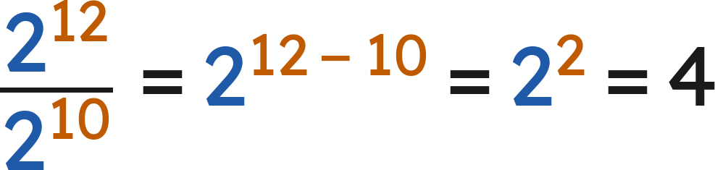
Whiteboards · Question 5 of 9
Which is the value?
, so the top is
Answer: D — 4
Grade 7 Accelerated · Unit 3 · Lesson 3 — Exponential Expressions
24

Slide 25
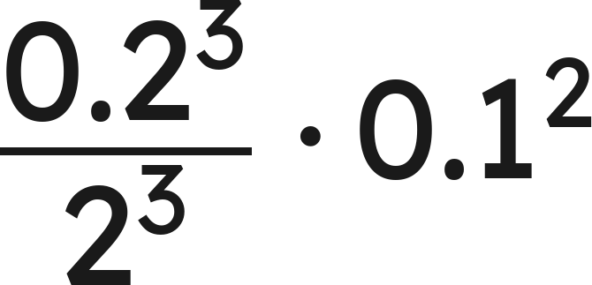
Whiteboards · Question 6 of 9
Which expression is equivalent?
A. 0.2⁰ · 0.1²
B. 0.2³ · 0.1²
C. 0.1⁵
D. 0.1⁶
Answer it.
Grade 7 Accelerated · Unit 3 · Lesson 3 — Exponential Expressions
25

Slide 26
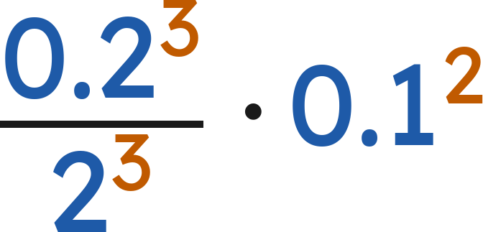
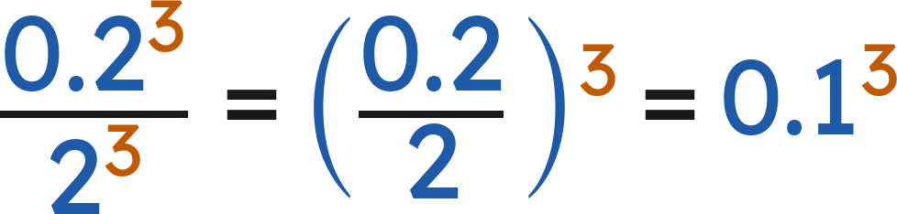
Whiteboards · Question 6 of 9
Which expression is equivalent?
Answer: C — 0.1⁵
Grade 7 Accelerated · Unit 3 · Lesson 3 — Exponential Expressions
26

Slide 27
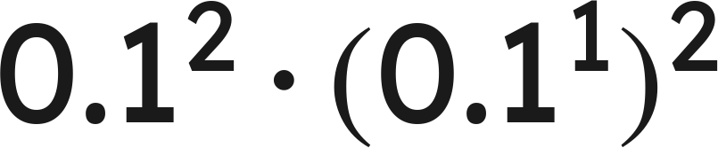
Whiteboards · Question 7 of 9
Answer it.
Grade 7 Accelerated · Unit 3 · Lesson 3 — Exponential Expressions
27

Slide 28
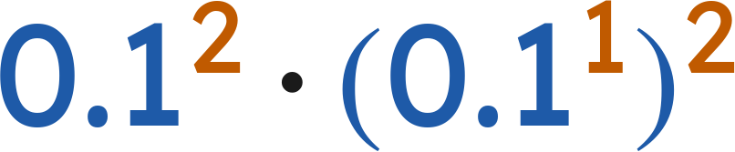
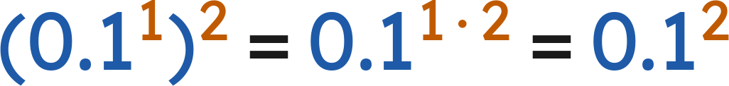
Whiteboards · Question 7 of 9
Answer: 0.0001
Grade 7 Accelerated · Unit 3 · Lesson 3 — Exponential Expressions
28

Slide 29
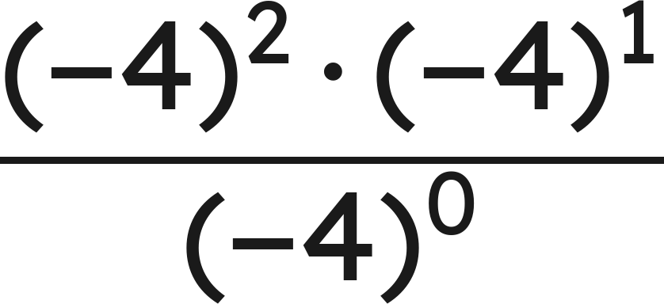
Whiteboards · Question 8 of 9
Answer it.
Grade 7 Accelerated · Unit 3 · Lesson 3 — Exponential Expressions
29

Slide 30
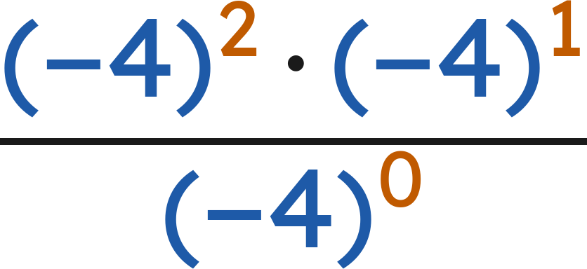
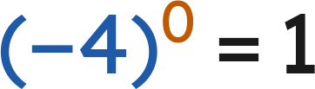
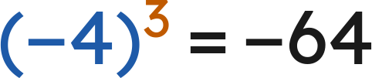
Whiteboards · Question 8 of 9
Top:
Bottom:
Answer: −64
Grade 7 Accelerated · Unit 3 · Lesson 3 — Exponential Expressions
30

Slide 31
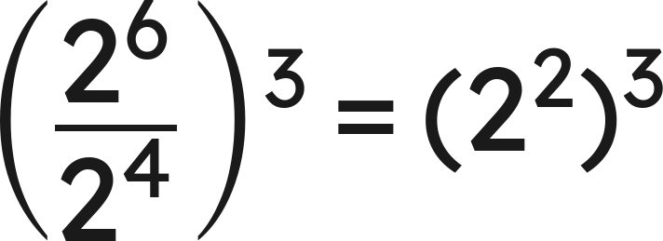
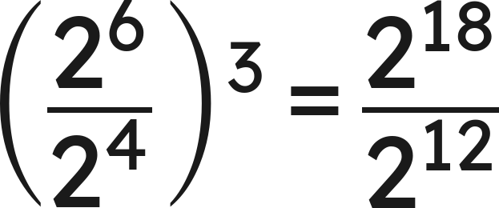
Whiteboards · Question 9 of 9
Winston writes
. Yvette writes
.
Do they get the same value? Explain.
Write your answer in sentences.
Grade 7 Accelerated · Unit 3 · Lesson 3 — Exponential Expressions
31

Slide 32





Whiteboards · Question 9 of 9
Winston writes
. Yvette writes
.
Do they get the same value? Explain.
Winston:
Yvette:
Answer: Yes — both give 2⁶ = 64
Grade 7 Accelerated · Unit 3 · Lesson 3 — Exponential Expressions
32

Slide 33







Independent Set
1.
Find the value.
2.
Find the value.
3.
Write as one power.
4.
Find the value.
5.
Find the value.
6.
Show that
and
have the same value.
Grade 7 Accelerated · Unit 3 · Lesson 3 — Exponential Expressions
33

Slide 34
IXL
1.
Open IXL and start today's skills.
2.
Work on paper where the question needs work. The answer box does not show it.
3.
Every skill listed is required, to a SmartScore of 67. Due at the start of the next class.
Today's skills — all required
Evaluate expressions using properties of exponents — ZE9
Grade 7 Accelerated · Unit 3 · Lesson 3 — Exponential Expressions
34

